Slide 1
Chapter 3 Periodicity
Wilt Gu

Slide 2
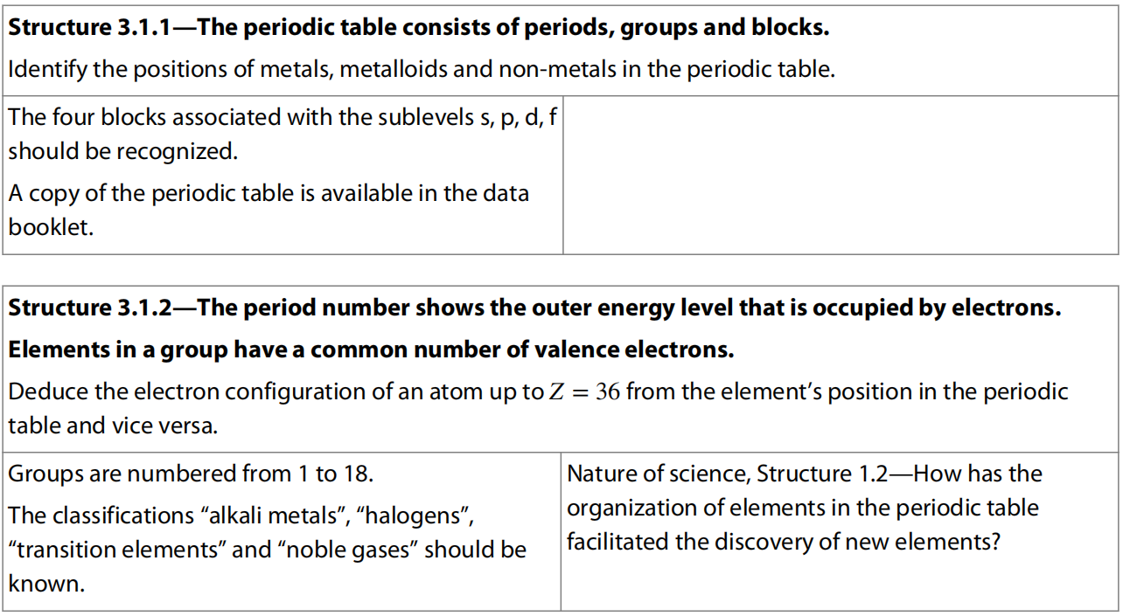
3.1 The Periodic Table

Slide 3
A Pattern of Elements – the Periodic Table
Johann Döbereiner first found that many elements can be grouped together in threes, which are called Döbereiner‘s triads.
John Newlands arranged the elements in a list in order of their atomic masses and found each element was often very similar to the one eight places above it.

Slide 4
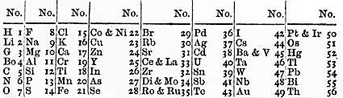
Element 1 Atomic mass | Element 2 Atomic mass | Element 3 Atomic mass
Lithium 7.0 | Sodium 23.0 | Potassium 39.0
Calcium 40.0 | Strontium 87.5 | Barium 137.0
Chlorine 35.0 | Bromine 80.0 | Iodine 127.0
Sulfur 33.0 | Selenium 79.0 | Tellurium 128.0
Carbon 12.0 | Nitrogen 14.0 | Oxygen 16.0
Ferrum 55.8 | Cobalt 58.9 | Nickel 58.6
Döbereiner's triads
Newlands Periodiska system 1866

Slide 5
Dmitri MENDELEEV and his Periodic Table
Took all the ideas and produced his famous Periodic Classification of the Elements.
Greatly improved people’s understanding of the chemical elements.
Successfully predicted many of the properties of the elements that had not been discovered at that time.

Slide 6
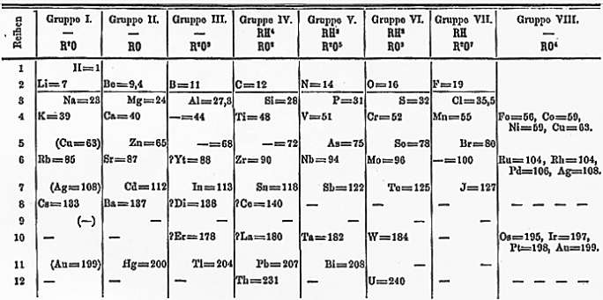
Mendeleev’s Periodiska System 1871

Slide 7
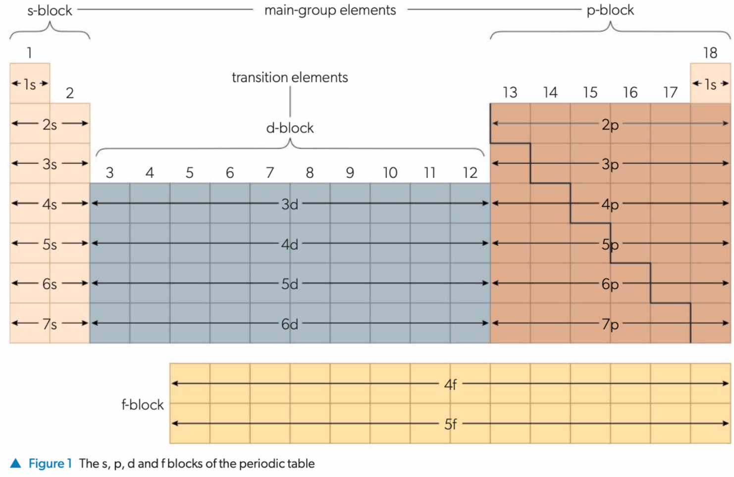

Slide 8
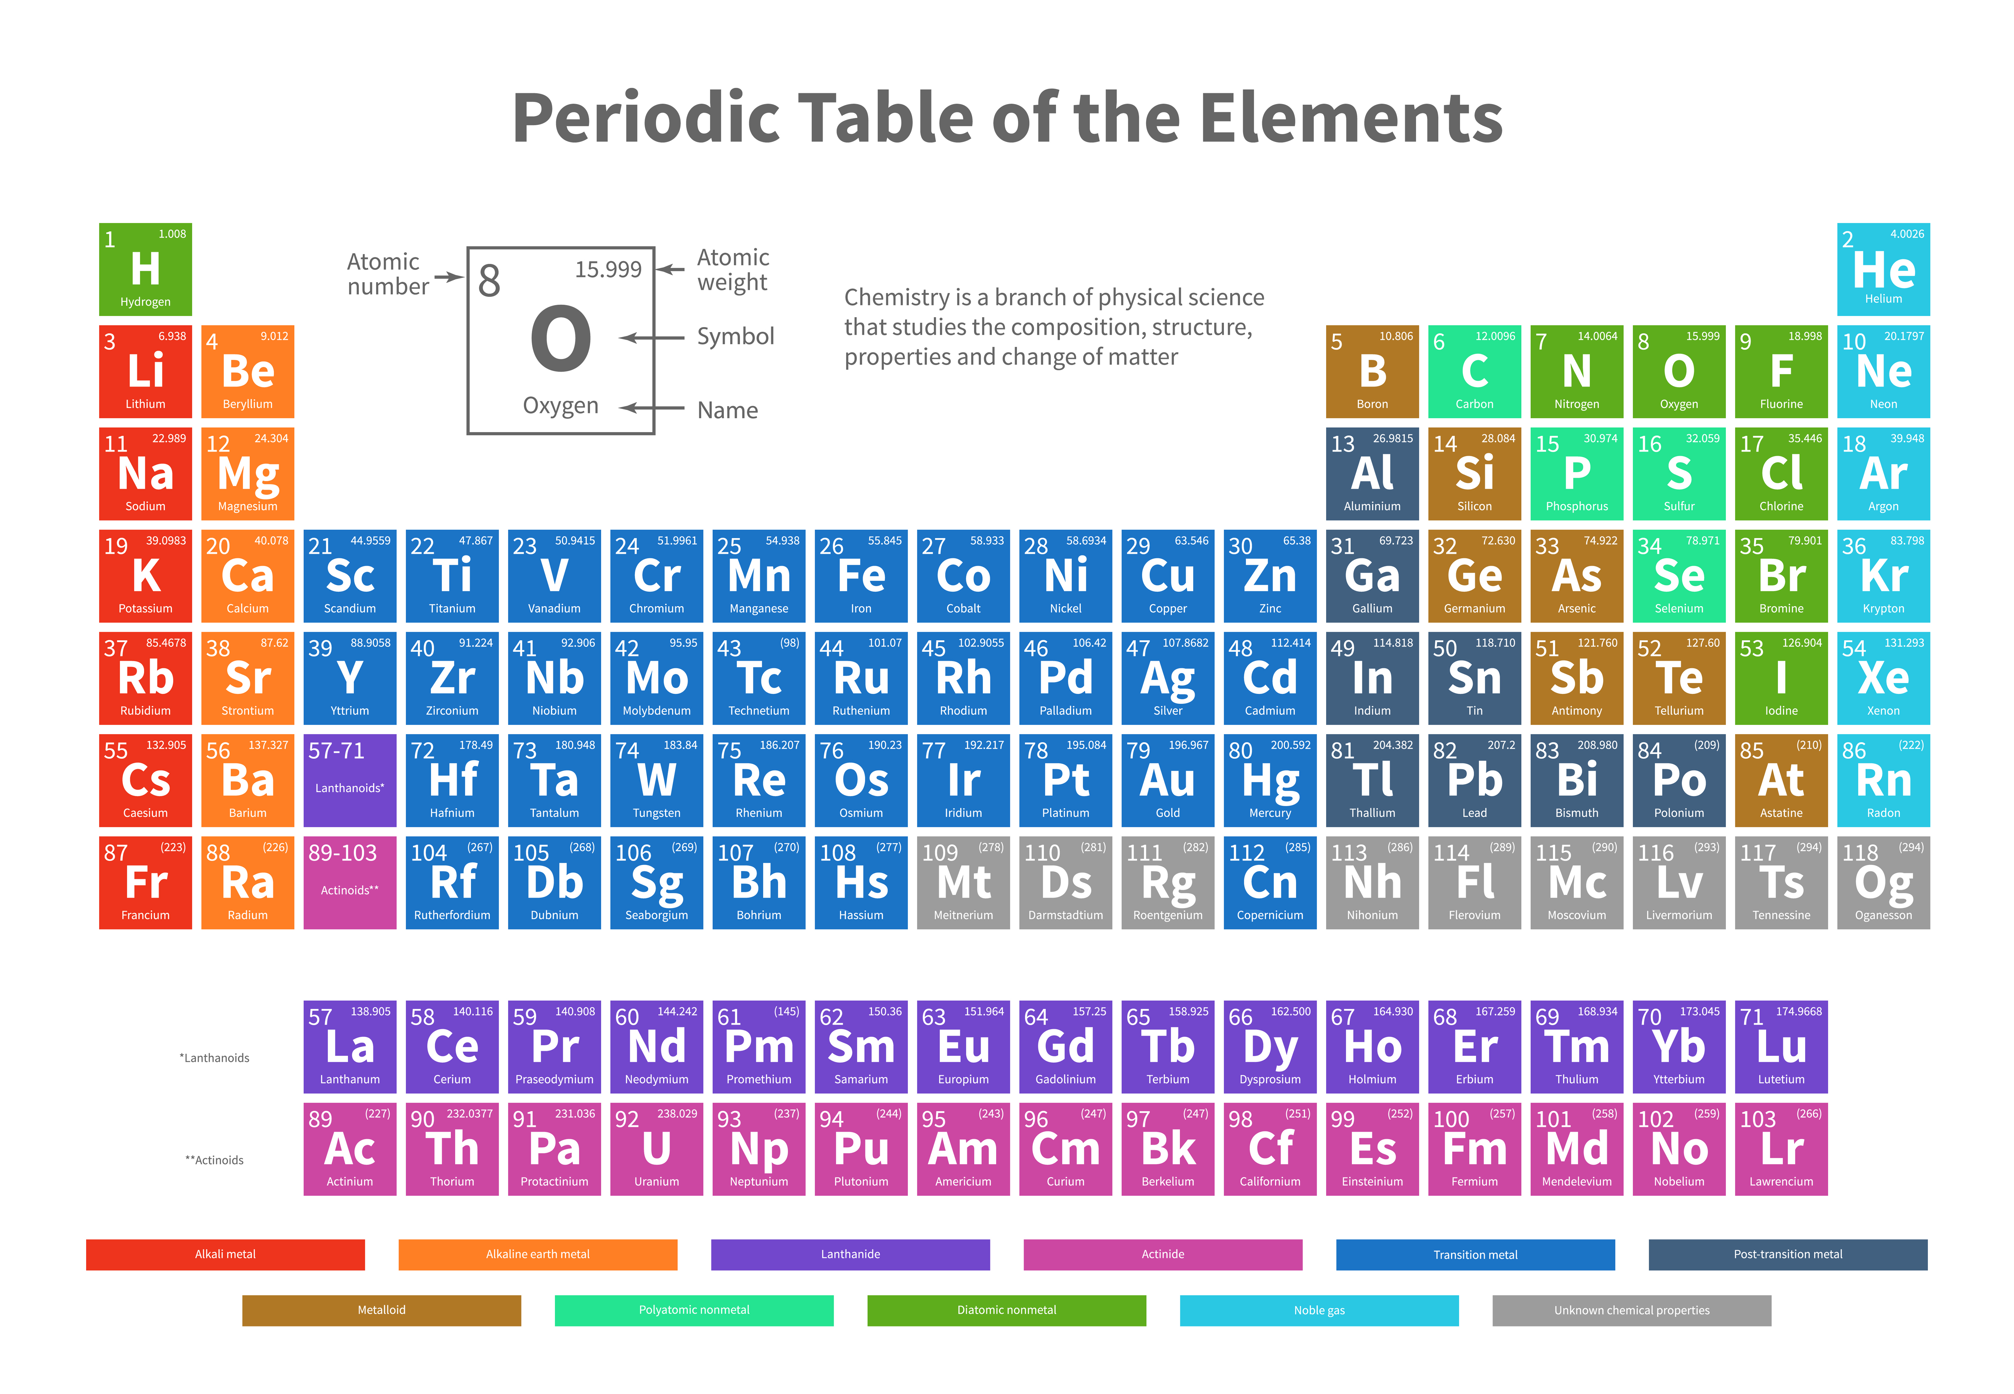

Slide 9
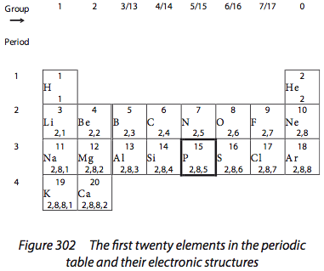
Order of element arrangement: Increasing atomic number (proton number)
Group: vertical column, same number of valence electrons, similar chemical properties
Period: horizontal row, chemical properties gradually change from metals to non-metals
Alkali metals, Halogens, Noble gases.

Slide 10
Electron configuration of the main group elements and first row d-block elements and their corresponding ions
Electron configuration of these elements can be determined from the block and the position of it in the periodic table.
Tl:
period 6 group 13:[Xe] 4f¹⁴ 5d¹⁰ 6s² 6p¹
Sn²⁺:
period 5 group 14: [Kr] 4d¹⁰ 5s²
Ra:
period 6 group 2: [Xe] 6s²
Cr³⁺:
period 4 group 6: [Ar] 3d³

Slide 11
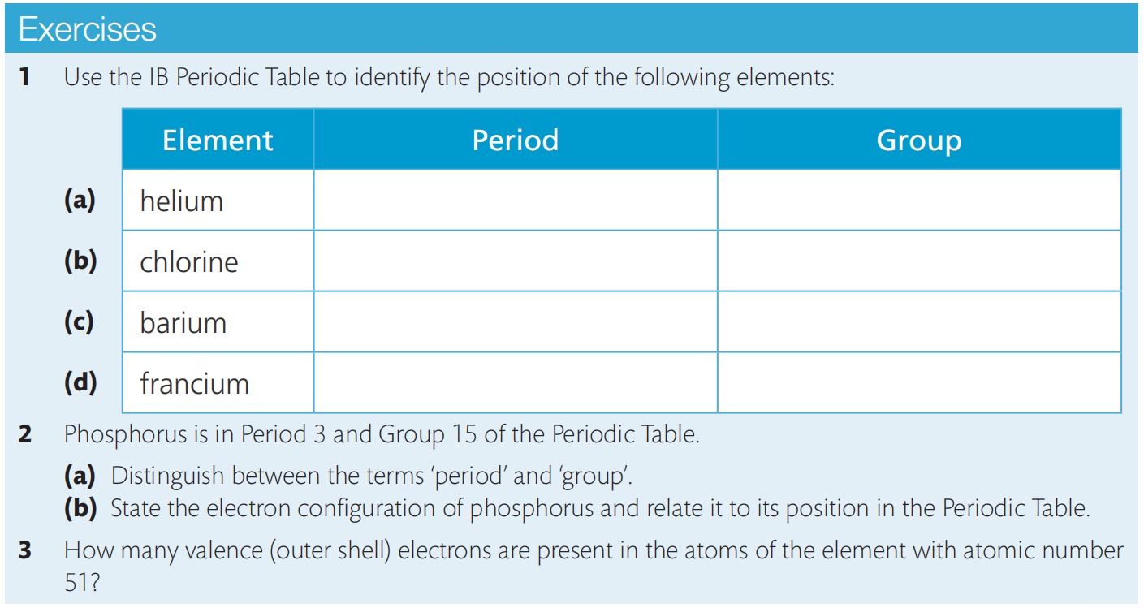
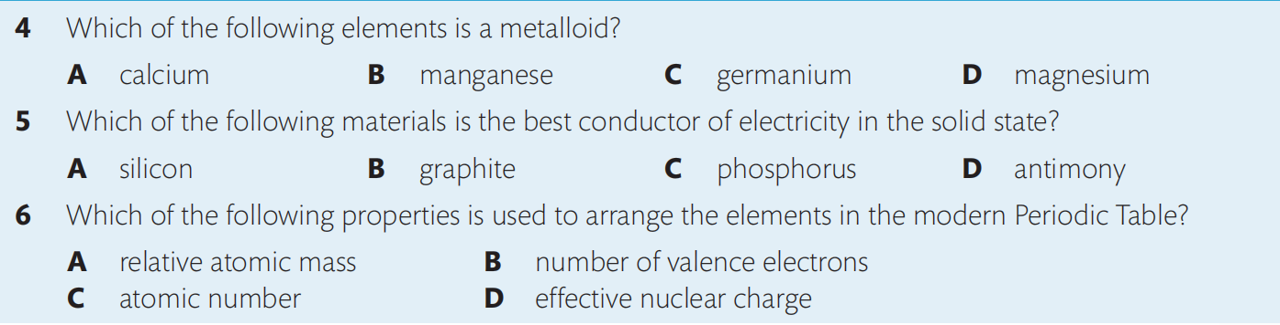

Slide 12
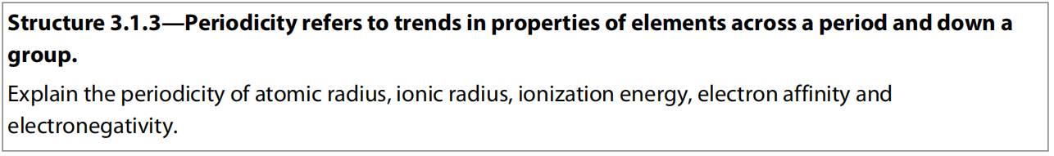
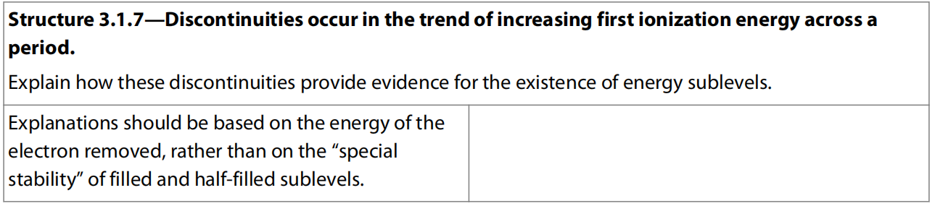
3.2 Periodicity in physical properties of atoms
HL Only

Slide 13
Physical properties
The elements in the Periodic Table are arranged to show how the properties of the elements repeat periodically.
This periodicity of the elements is reflected in their physical properties.
The atomic and ionic radii, electronegativity, ionization energy, and electron affinity of the atoms are of particular interest as they explain the periodicity of the chemical properties.

Slide 14
Effective Nuclear Charge (ENC)
The nuclear charge of the atom is given by the atomic number and so increases by one between successive elements in the table, as a proton is added to the nucleus.
The outer electrons, which determine many of the physical and chemical properties of the atom, do not experience the full attraction of this charge as they are shielded from the nucleus and repelled by the inner electrons.
The presence of the inner electrons reduces the attraction of the nucleus for the outer electrons.
The effective charge ‘experienced’ by the outer electrons is less than the full nuclear charge.

Slide 16
Consider, for example, a sodium atom.
The nuclear charge is given by the atomic number of element (Z = 11).
The outer electron in the 3s orbital is shielded from these 11 protons by the 10 electrons in the first and second principal energy levels (1s² 2s² 2p⁶).
Consider the first four elements in Period 3, as shown in the table below.

Slide 17
As the period is crossed from left to right, one proton is added to the nucleus and one electron is added to the valence electron energy level.
The effective charge increases with the nuclear charge as there is no change in the number of inner electrons, as all the atoms have a noble gas structure of 10 electrons ([Ne] = 1s² 2s² 2p⁶).
If we assume that the noble gas core is completely shielding, then the 10 inner electrons of the neon core make the effective nuclear charge 10 less than the nuclear charge.

Slide 18
The changes down a group can be illustrated by considering the elements in Group 1, as shown in the table below:
As we go down the group, the increase in the nuclear charge is largely offset by the increase in the number of inner electrons; both increase by the same number between successive elements in the group.
So the effective nuclear charge always equals to the number of outer shell electrons for its neutral atom.
Element | Li | Na | K | Rb
Nuclear Charge | 3 | 11 | 19 | 37
Electron Configuration | [He] 2s¹ | [Ne] 3s¹ | [Ar] 4s¹ | [Kr] 5s¹
ENC | ≈ 3-2 = +1 | ≈ 11-10 = +1 | ≈ 19-18 = +1 | ≈ 37-36 = +1

Slide 19
Trends of atomic radius in groups and in periods
The concept of atomic radius is not as straightforward as you may think. We saw that electrons occupy atomic orbitals, which give a probability description of the electrons’ locations, but do not have sharp boundaries.
The atomic radius r is measured as half the distance between neighboring nuclei that are covalently bonded.
For many purposes, it can be considered as the distance from the nucleus to the outermost electrons of the Bohr atom.
Since the covalently bonded atoms have their electron clouds overlap a little bit, the measured atomic radii are a bit smaller than the real radius when they are alone.

Slide 20
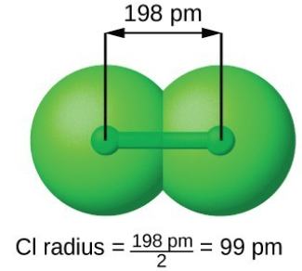

Slide 21
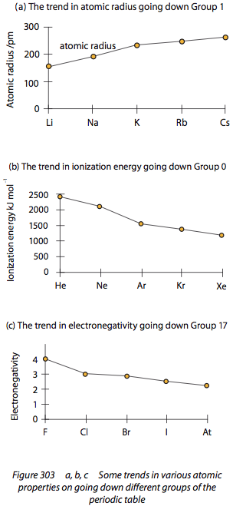
Going down the group, the atomic radius increases, because they have the same effective nuclear charge (ENC), but the number of occupied electron shells increases, so the atomic radius increases.

Slide 22
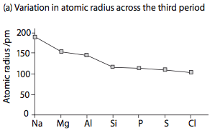
Going across the period from left to right, the atomic radius decreases, since they have the same number of occupied shells, but their effective nuclear charge (ENC) is increasing, so the atomic radius decreases.

Slide 23
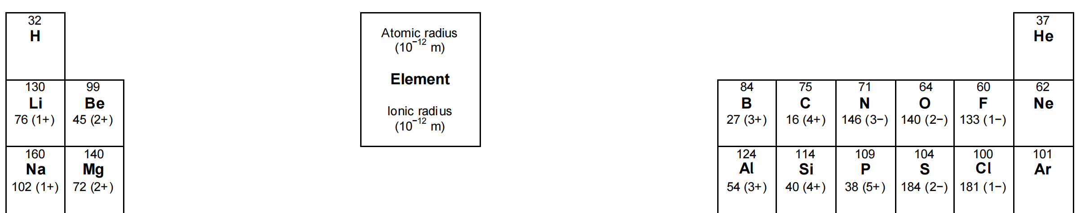
Noble gases do not form covalent bond so they are measured the distance between neibouring atoms in their solid which have some distance between rather than overlapped by covalent bonds between bonding atoms.

Slide 24
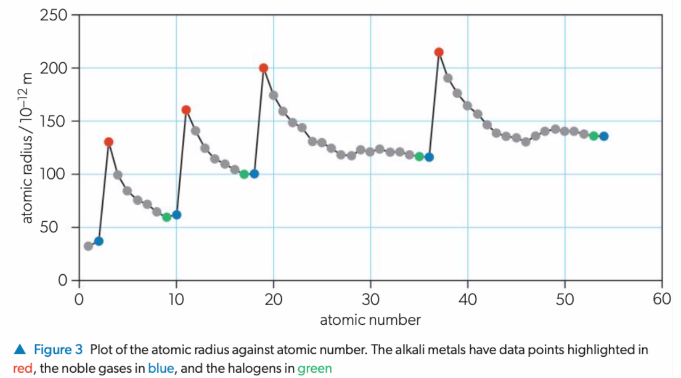

Slide 25
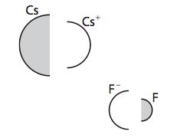
Size of Atom Vs its Ion
The size of an atom always decreases when it is converted into a positive ion (cation) since there is one less occupied shells while the number of protons remains the same.
The size of an atom always increases when it is converted into a negative ion (anion) since there is more valence electrons so stronger repulsions between electrons while number of protons and number of occupied shells remain the same.
Almost every common cation is smaller than any anion, the converse only being true for the extremities.

Slide 26
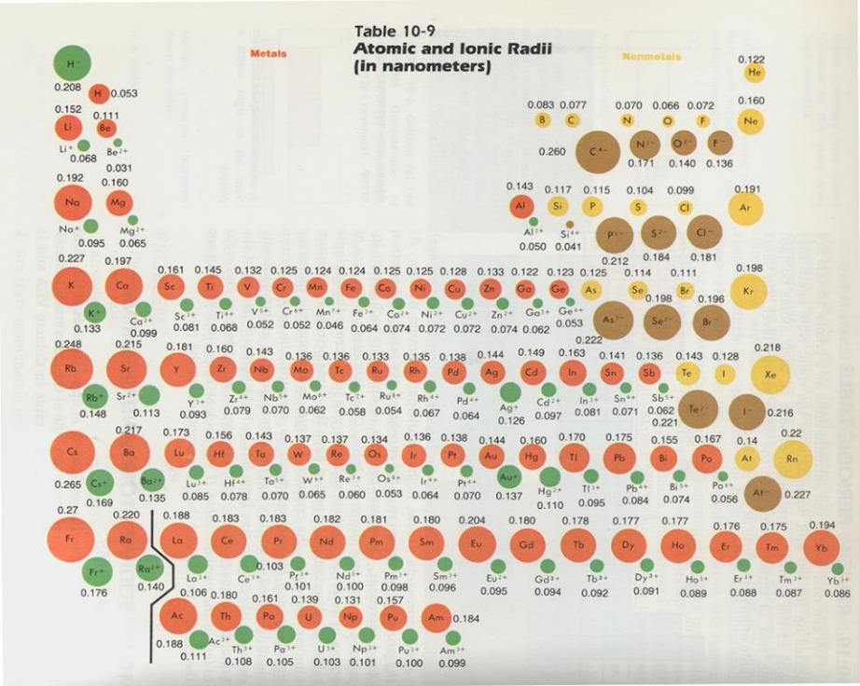

Slide 27
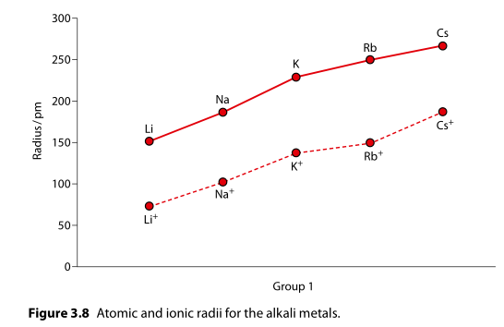

Slide 28
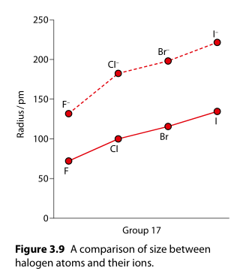

Slide 29
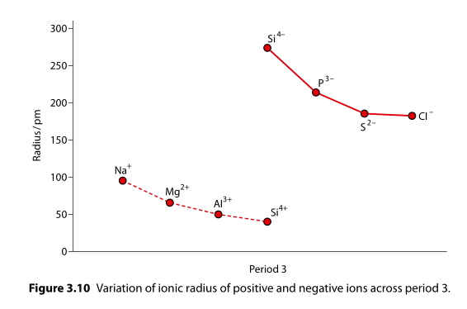

Slide 30
Metals tend to form cations that have one less occupied electron shell so they have much lower ionic radii compared to the nonmetal anions.
With increasing effective nuclear charge (ENC) and same number of occupied electron shells, their ionic radii decrease across the period.
Nonmetals tend to form anions that have fully occupied electron shell so they have much greater ionic radii than the metal cations.
With increasing effective nuclear charge (ENC) and same number of occupied electron shells, their ionic radii decrease across the period.

Slide 31
Trends of Electronegativity in Groups and in Periods
Electronegativity: The measure of the ability of attracting electrons of an atom in a covalent bond for a chemical element.
This is the most important and versatile property for chemical elements.

Slide 32
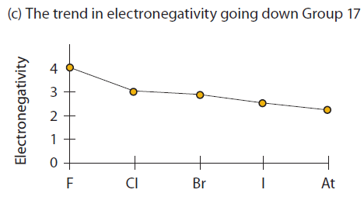
Going down the group, the electronegativity decreases, since they have the same number of effective nuclear charge (ENC), and the atomic radius is increasing, so the attraction between the nucleus and the shared electrons is getting weaker, thus the electronegativity decreases.

Slide 33
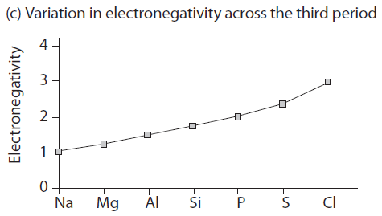
Going across the period, the electronegativity increases, since their atomic radius is decreasing, and also the effective nuclear charge (ENC) is increasing, so the attraction between the nucleus and the shared electrons is getting stronger, thus the electronegativity increases.

Slide 34
Since the first 3 noble gases (He, Ne, and Ar) do not form covalent bonds with any other elements, they do not even have an electronegativity value (probably they do but it is impossible to measure them).
Kr and Xe could form covalent bonds with fluorine so they have electronegativity values.

Slide 35
Trends in 1st Ionization Energy in Groups And Periods
1st Ionization Energy: The minimum energy required to remove 1 electrons from each of 1 mol of gaseous atoms (unit: kJ·mol⁻¹).
X (g) → X⁺ (g) + e⁻
So for whatever rank of ionization energy, the equation representing it would be:
n^{th} ionization energy: X^{(n-1)+} (g) → X^{n+} (g) + e⁻

Slide 36
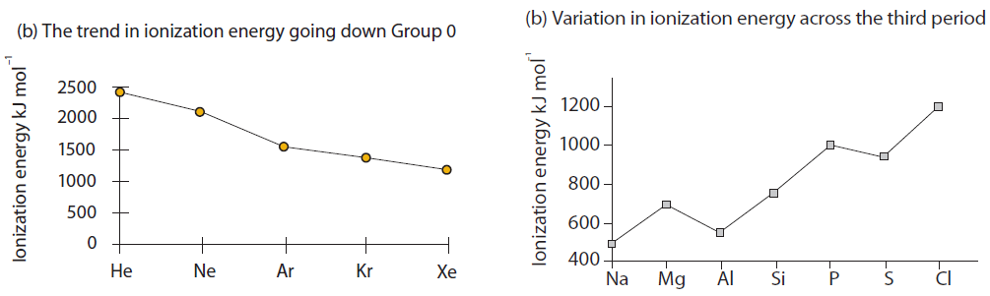
Going down the group, the 1st ionization energy (1st IE) decreases, since they have the same number of effective nuclear charge (ENC), and the atomic radius increases, so the attraction between the nucleus and the electron to be removed becomes weaker, thus the first ionization energy decreases.

Slide 37
Going across the period, the 1st ionization energy (1st IE) generally increases, since they have an increasing effective nuclear charge (ENC), and also they have decreasing atomic radius, so the attraction between the nucleus and the electron to be removed gets stronger, thus the first ionization energy increases in general.

Slide 38
Discontinuities in the trend of first ionization energy across a period (HL Only)
Group 13 elements have lower 1st ionization energy than their neighboring Group 2 elements, because the first electron removed from Group 13 element is from p sub-shell, while that lost from Group 2 element is from s sub-shell, and p sub-shell is with higher energy than s sub-shell in the same energy levels, so it requires less energy to remove electron from p sub-shell than from s sub-shell.

Slide 39
Group 2 → 3
Electron lost from Group 3 element is from p orbital, while that lost from Group 2 element is from s orbital.
p orbital is higher energy than s orbital, so easier to lose electron.

Slide 40
Discontinuities in the trend of first ionization energy across a period (HL Only)
Group 16 element loses its first electron from orbital with 2 electrons since it has an electron configuration of ns² np⁴, while its neighboring Group 15 element loses electron from orbital with 1 electron since it has an electron configuration of ns² np³, and the extra electron-electron repulsions make it easier to lose electron from p⁴ than from p³.

Slide 41
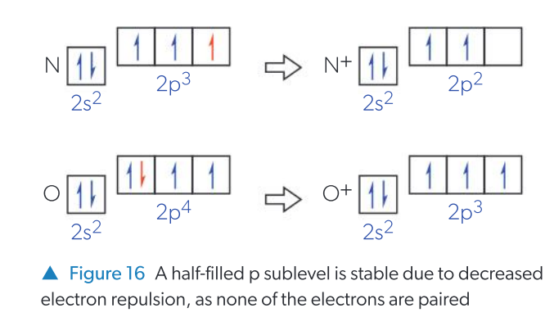
Group 5 → 6
Group 6 element loses electron from orbital with 2 electrons.
Group 5 element loses electron from orbital with 1 electron.
Extra electron-electron repulsions make it easier to lose electron from p⁴ than p³.

Slide 42
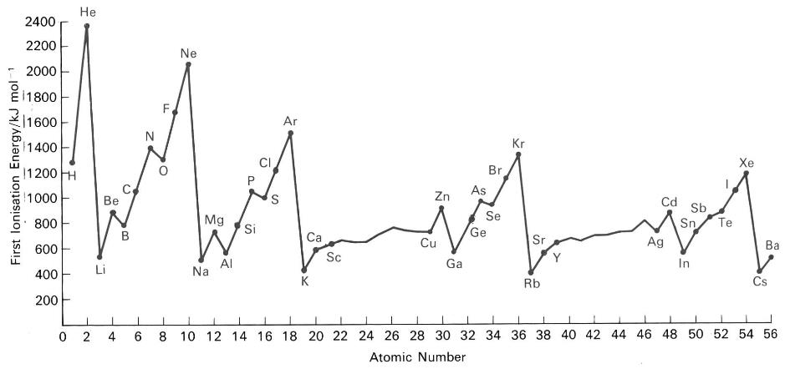
1st ionisation energy of 1-56 elements

Slide 43
Metals have lower ionization energies and electronegativities than non-metals
The ability of metals to conduct electricity is due to the availability of their valence electrons to move away from the atomic nucleus.
This can be related to their low ionization energies and electronegativities.
There is a transition from metal to metalloid and non-metal from left to right as these properties increase.
The diagonal band of metalloids which divides the metals from the non-metals can also be related to the similar electronegativities of these elements.

Slide 44
1st electron affinity
The 1st electron affinity of an element is the energy change (means it could be either exothermic or endothermic) when one mole of electrons is added to one mole of gaseous atoms to form one mole of gaseous ions:
X (g) + e– → X– (g)
So for whatever rank of electron affinity, the equation representing it would be:
n^{th} electron affinity: X^{(n-1)-} (g) + e⁻ → X^{n-} (g)

Slide 45
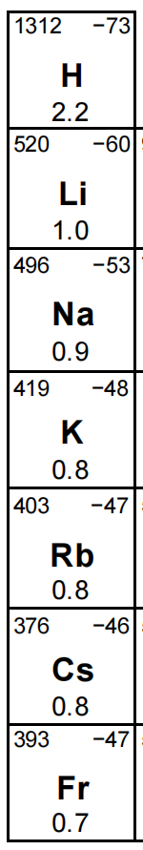
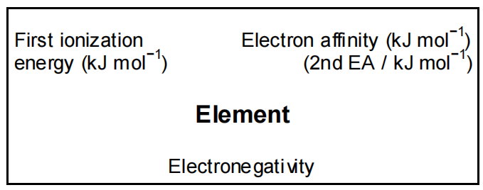
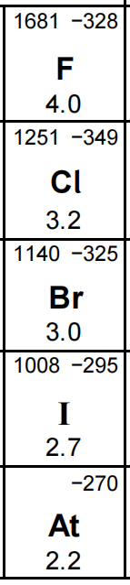
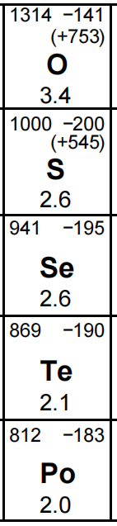
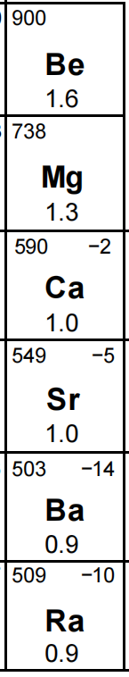
Going down the group, the 1st electron affinity increases (becomes less negative), since they have the same number of effective nuclear charge (ENC), and the atomic radius increases, so the attraction between the nucleus and the additional electron is getting weaker, so less energy would be released during the process of gaining electron.
But the trend does NOT always work.

Slide 46
Going across the period, the 1st electron affinity generally decreases (becomes more negative), since they have the increasing effective nuclear charge (ENC), and the atomic radius decreases, so the attraction between the nucleus and the additional electron is getting stronger, so more energy would be released during the process of gaining electron.

Slide 47
Discontinuities in the trend of first electron affinity across a period (HL Only)
The electron affinities reach a maximum for Group 2 and Group 5 elements.
Group 2 elements have an electron configuration ns², so the added electron must be placed into a np orbital which is further from the nucleus and so experiences reduced electrostatic attraction due to shielding from electrons in the ns orbital.

Slide 48
Discontinuities in the trend of first electron affinity across a period (HL Only)
Group 15 elements have the configuration ns²np_{x}¹p_{y}¹p_{z}¹ so the added electron must occupy a p orbital that is already singly occupied: the attraction between the electron and atom is less than expected as there is increased inter-electron repulsion.

Slide 49
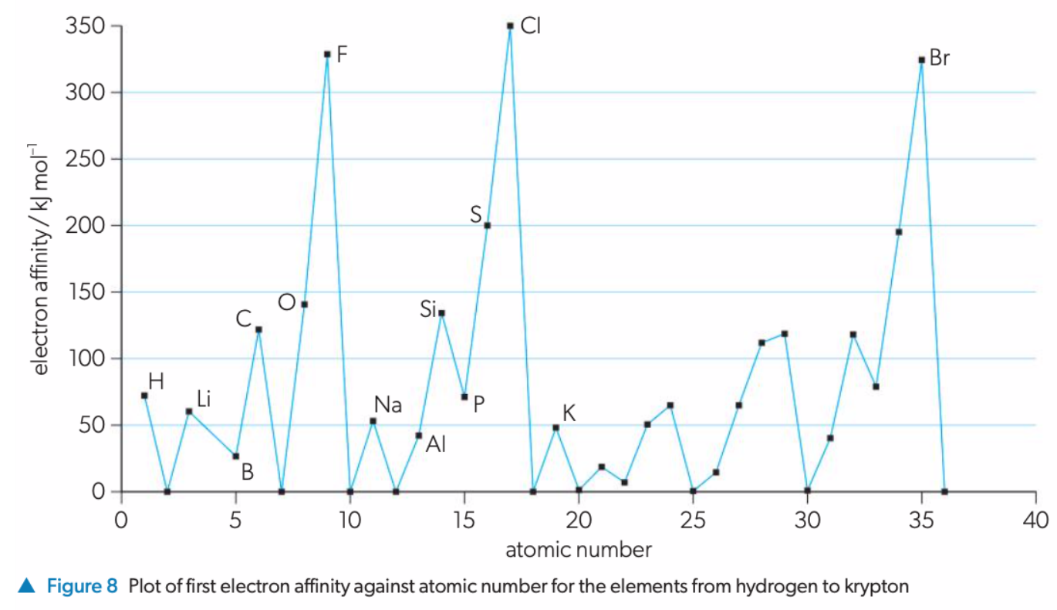

Slide 50
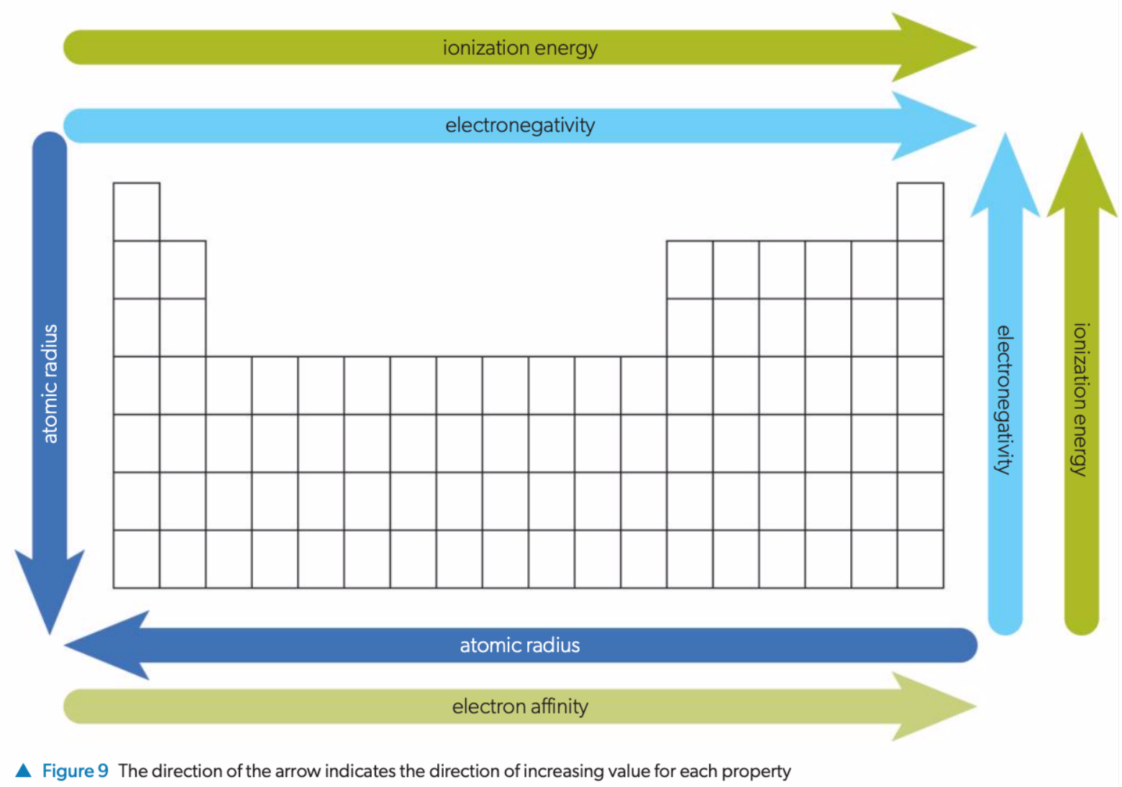

Slide 51
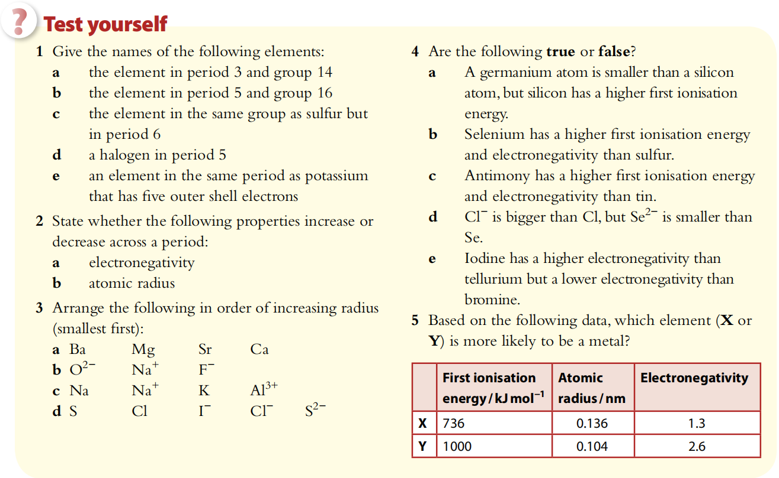

Slide 52
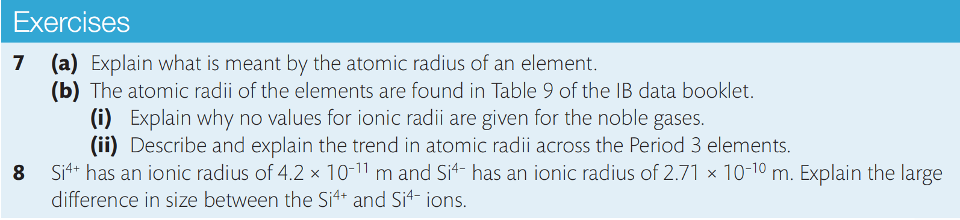
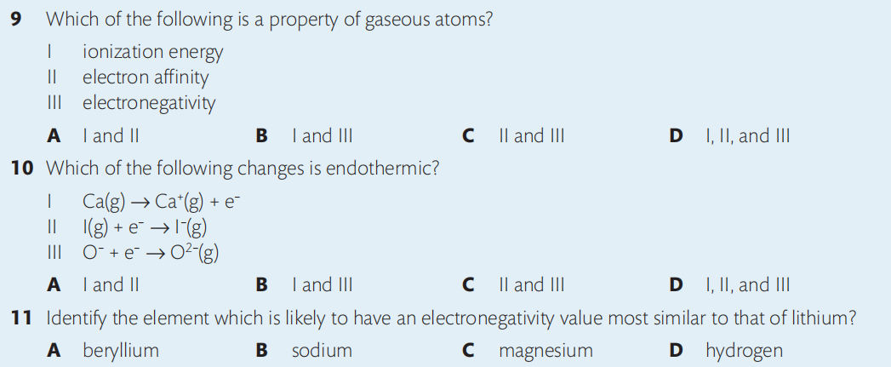

Slide 53
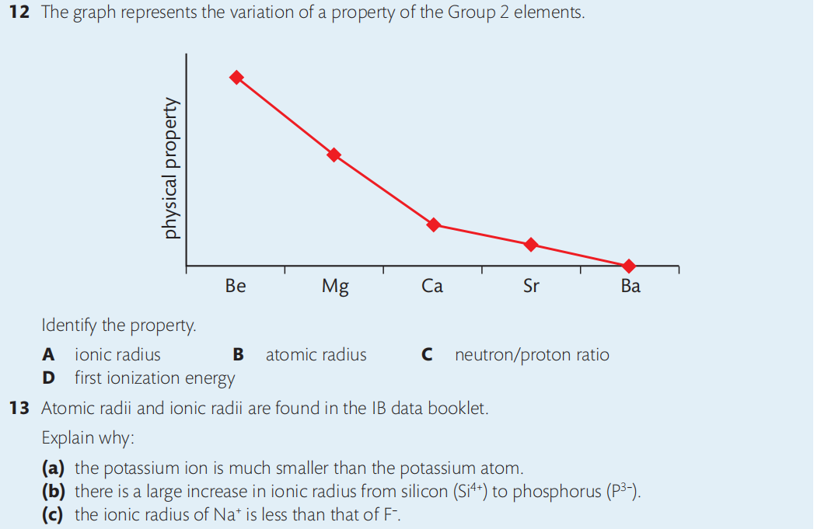

Slide 54
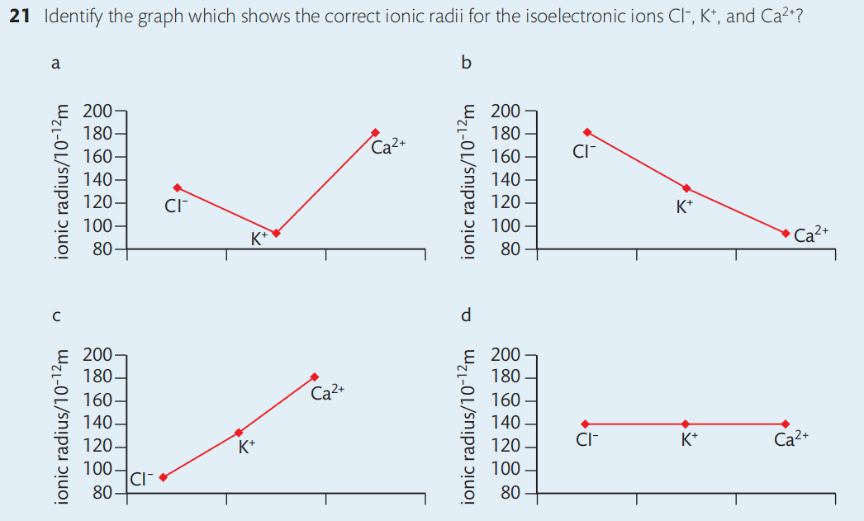

Slide 55
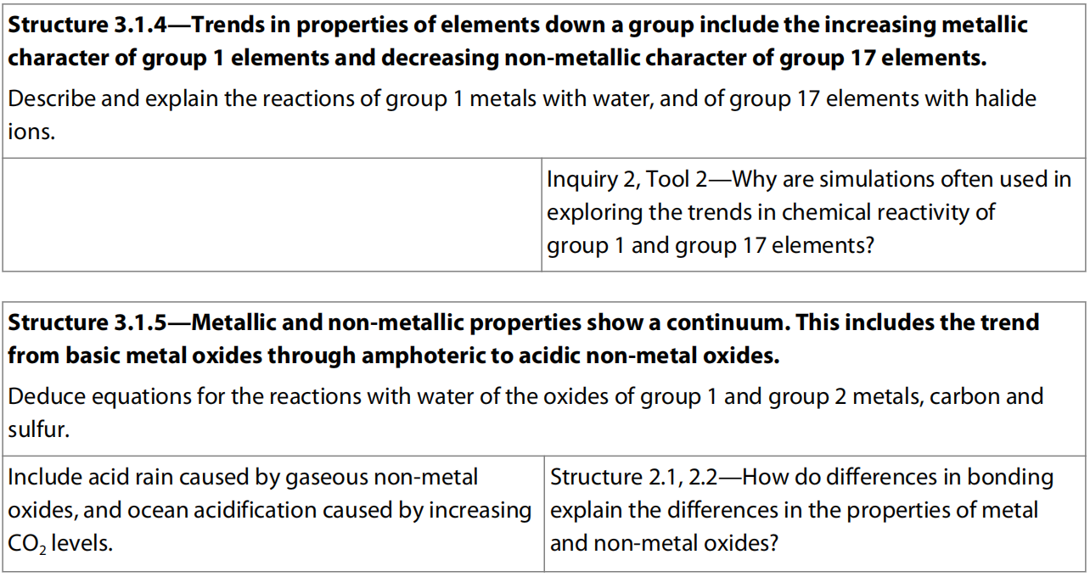
3.3 Periodicity in chemcial properties of elements

Slide 56
Metallic properties and non-metallic properties
Metallic character describes the set of chemical properties that are associated with the elements classified as metals in the periodic table. Metallic character depends on the ease of an element to lose its outer valence electrons.
Non-metallic character describes the set of chemical properties that are associated with the elements classified as nonmetals in the periodic table. Non-metallic character depends on the ability of an element to fulfill its outer valence shell with additional electrons.
The lower ionization energy an element has, the more metallic it is, and the higher electronegativity an element has, the more non-metallic it is.

Slide 57
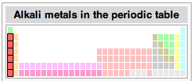
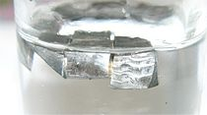
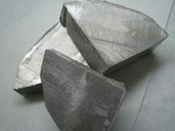
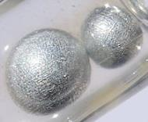
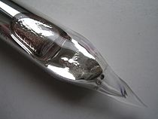

Group 1: Alkali metals
Soft metals
Low melting points
Low density
K
Li
Na
Rb
Cs

Slide 58
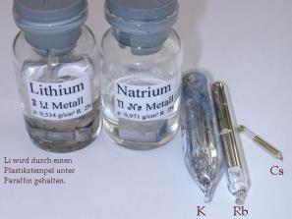
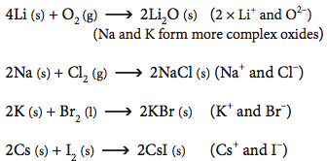
Chemically very reactive
Very strong reducing agents
Tarnish rapidly on exposure to air
Combine directly with reactive non-metals: O₂, Cl₂, Br₂, I₂ to form ionic compounds

Slide 59
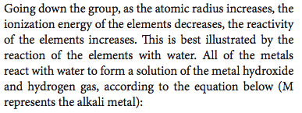
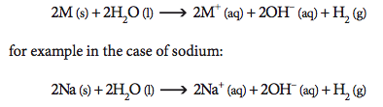
Reaction with water

Slide 60
Observations when react with water
Observations in common (Li, Na, and K):
bubbles form
metal solid floats on water surface
metal solid gradually disappears
Observations for Na only:
Na metal melts into a silvery ball
Observation for K only:
K metal melts into a silvery ball
lilac flame occurs
Rb and Cs would explode violently when contact with water.

Slide 61
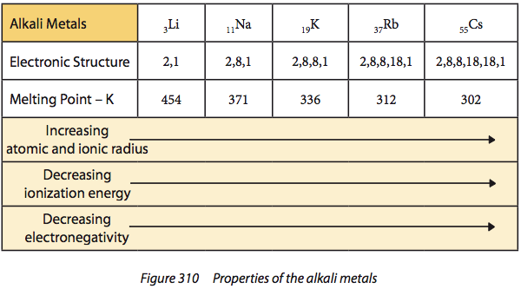
Increasing reactivity going down the group

Slide 62
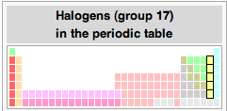
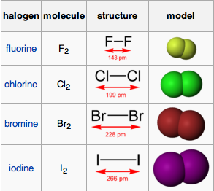

Group 17: Halogens
Diatomic molecules with different physical states at RTP -- due to different strength of intermolecular forces (IMF)
K
Cl₂
Br₂
I₂
Reactive nonmetals---all with high electronegativities, readily gain one electron to complete valence shell forming halide ions (F⁻, Cl⁻, Br⁻, and I⁻) so can act as strong oxidizing agents
Reactivity decreases going down the group

Slide 63


Slide 64

Solubility
Halogens slightly soluble in polar solvents --- water, ethanol
much more soluble in non-polar solvents ---
cyclohexane, hexane
C₆H₆
Water
Cl₂
Br₂
I₂

Slide 65


In aqueous solution, the halogens (Cl₂, Br₂, I₂) dissociate slightly to form an acidic solution:
X₂(aq) + H₂O(l) H⁺(aq) + X⁻(aq) + HXO
e.g. Cl₂(aq) + H₂O(l) H⁺(aq) + Cl⁻(aq) + HClO
Chloric (I) acid
Act as an oxidant
Applications:
Bleaches
Disinfectants (toxic to microbes)
Water treatment (chlorine)
Litmus paper in regular acid
Litmus paper in chlorine water

Slide 66
Reaction between alkali metals and halogens
All sets react rapidly with Cs + F2 reacts most readily / vigorously and forms most ionic product CsF.
2 M + X₂ → 2 MX
e.g. 2 Cs + F₂ → 2 CsF

Slide 67


Salts containing halide ion
Usually white and soluble in water (colorless solutions);
Silver (Ag), Lead (Pb) halides are insoluble (colored precipitates).
Halide ion tests
AgI
AgBr
AgCl
AgF
PbI₂
Ag halides

Slide 68


AgCl
AgBr
AgI

Slide 69


Halogen displacement reactions
Going down the group, halogens become less powerful oxidizing agents (electronegativity decrease).
Higher halogen will displace/oxidize a lower halide ion from its salts:
Colorless to brown
Chlorine water added in KBr solution

Slide 70


Slide 71



Group 18: the noble gases

Slide 72


Slide 73



Slide 74

Trends in period 3 oxides
P₄O₁₀
Ionic with covalent character
P₄O₆

Slide 75
Basic oxide: oxide that can react with acid to form salt and water. Oxide ion combines with 2 H⁺ to form water.
Acidic oxide: oxide that can react with alkali to form salt and water.
Relatively strong basic oxide reacts with water to form alkalies, e.g. Na₂O, K₂O.
Relatively strong acidic oxide reacts with water to form soluble acids, e.g. CO₂, SO₃, P₄O₁₀, Cl₂O₇.
Amphoteric oxide: oxide that can both react with acid and alkali to form different salts and water.

Slide 76


Slide 77


Slide 78


Slide 79


Slide 80


Causes of acid deposition
All rain water is naturally acidic owing to the presence of dissolved carbon dioxide, which dissolves in water to form the weak acid carbonic acid, H₂CO₃.
Carbonic acid ionizes to form the following equilibrium:
This gives a solution with a minimum pH of 5.6.
Acid rain refers to solutions with a pH below 5.6, and which therefore contain additional acids.
The main contributors to acid rain are the oxides of sulfur and nitrogen, which are primary pollutants.
Acid rain is a secondary pollutant produced when these acidic gases dissolve in water.

Slide 81
Test tubes containing normal
rain water (left) and acid rain
(right) with universal indicator
solution added to show
acidity. The normal rain water
has a pH of above 5.6, while
the acid rain has a lower pH.
In this example the pH = 4.0.

Slide 82
Sulfur oxides
Sulfur dioxide, SO₂, is produced from the burning of fossil fuels, particularly coal and heavy oil in power plants used to generate electricity.
It is also released in industrial processes of smelting where metals are extracted from their ores.
It is estimated that about 50% of annual global emissions of sulfur dioxide come from coal.
Sulfur dioxide is a colourless gas with a sharp smell.
It dissolves in water to form sulfurous acid, H₂SO₃ (aq).

Slide 83


Formation of sulfuric acid
Sulfur dioxide can also be oxidized to sulfur trioxide, SO₃, which then dissolves in water to form sulfuric acid, H₂SO₄.
Sulfurous acid, H₂SO₃, can also be oxidized to form sulfuric acid, H₂SO₄.

Slide 84
Mechanism of oxidation of SO₂ (not required)
There are several mechanisms that might occur in these reactions, and the chemistry is complex given the wide range of conditions and other chemicals found in the atmosphere.
Ozone (O₃) or hydrogen peroxide (H₂O₂) present as pollutants in the atmosphere, can be involved.
A more detailed study involves hydroxyl free radicals, •HO, which form by reactions between water and atomic oxygen or ozone.

Slide 85
Nitrogen oxides
Nitrogen monoxide, NO, is produced mainly from internal combustion engines, where the burning of the fuel releases heat energy that causes nitrogen and oxygen from the air to combine.
A similar reaction gives rise directly to the brown gas, nitrogen dioxide, NO₂.
Nitrogen dioxide also forms from the oxidation of nitrogen monoxide:

Slide 86

Nitrogen dioxide dissolves in water to form a mixture of nitrous acid (HNO₂) and nitric acid (HNO₃).
Alternatively, nitrogen dioxide can be oxidized to form nitric acid.
Nitrous acid, HNO₂, can also be oxidized to form nitric acid, HNO₃.

Slide 87
Mechanism of oxidation of NO_{x} (not required)
These reactions also proceed via different mechanisms, depending on the conditions and chemical cocktail in the atmosphere.
Photo-oxidation, the presence of ozone, and hydroxyl free radicals (•HO) all contribute to the production of nitrous acid and nitric acid.

Slide 88
In summary, a complex set of reactions in the atmosphere converts the primary pollutants SO₂ and NO into acid rain.
The main active components of acid rain are H₂SO₃ (aq), H₂SO₄ (aq), HNO₂ (aq), and HNO₃ (aq).

Slide 89


Slide 90
Ocean Acidification
Oceans absorb a large proportion of the carbon dioxide released into the atmosphere.
As a result, carbonic acid is formed in the ocean and causes ocean acidification and lower the pH of ocean.
Increased ocean acidity can affect the ability of coral reefs and shellfish to calcify their skeletons and so kill a lot of them as well as affecting the whole ecosystems that they are in.
SO₂ and NO₂ that cause acid rain are way insufficient to significantly affect ocean acidity although sulfuric and nitric acids are strong ones.

Slide 91



Slide 92


3.4 Oxidation number

Slide 93
Oxidation Number
Bonding is often not purely ionic or covalent, but rather occurs on a continuum with unequal sharing of electrons.
The oxidation number, or oxidation state, of an atom is the charge which that atom would have if all covalent bonds were broken so that the more electronegative atom kept all the electrons in the bond, hence the sign (+ or -) is always given.
For example in water (H₂O) the ions produced would be two H⁺ and an O²⁻ hence in water the oxidation state of hydrogen is +1 and that of oxygen is -2.

Slide 94
Rules to determine oxidation number of each element in a compound
(1) The total oxidation state of the atoms in a species is equal to the electrical charge it carries. Hence all elements in the elemental state have an oxidation state of zero, the total oxidation number of a neutral molecule is zero and that of ions is equal to the charge.

Slide 95
(2) Some elements almost always have the same oxidation state in their compounds, with a few exceptions.
a) Fluorine is –1 (no exceptions).
b) Group 1 metals are +1, group 2 metals are +2, Al is +3, Zn is +2, Ag is +1 (no exceptions).
c) Hydrogen is +1 (except in the hydride ion, H– where it is –1).
d) Polyatomic ions have their own fixed oxidation number. E.g. CO₃²⁻ is –2, SO₄²⁻ is –2, NO₃⁻ is –1, NH₄⁺ is +1.
e) Oxygen is –2 (except -1 in hydrogen peroxide, H₂O₂, and other peroxides, Na₂O₂, K₂O₂, etc.).
f) Halogens (Cl, Br, & I) are –1 (except when bonded to oxygen or a halogen that is higher in the group).

Slide 96
Assign the oxidation number of the underlined elements in the following compounds.
(1) KMnO₄ (2) K₂MnO₄ (3) K₂Cr₂O₇
(4) H₃PO₂ (5) K₂O₂ (6) KO₂
(7) OF₂ (8) ScCl₃ (9) C₂H₆

Slide 97
(10) C₂H₅OH (11) Ag₂CrO₄ (12) N₂O₄
(13) Na₂S₂O₃ (14) Na₂S₄O₆ (15) NH₄BrO₄
(16) OsO₄ (17) TiOCl (18) Na₂SnO₃
(19) C₃H₆O₃ (20) Na₂FeO₄

Slide 98




